Slide 1
Merge module 7
Note to other teachers and users of these slides. Feel free to use or modify these slides as you wish. If you use a significant portion of these slides in your own lecture, please include this message, or the following link to the source repository of Michele’s lectures on github:
https://github.com/samorani. Comments and corrections are welcome.

Slide 2
Announcement
The midterm is on 5/10
PART 1 (in class)
A few questions of the same style as the HW
Open book, open internet
But you cannot communicate with anybody
(Keep in mind that in job interviews you should avoid looking up easy stuff online)
Content covered: up to 5/3 included
PART 2 (take-home)
You will be given a data set to clean and to analyze
You will have a week to do it
Content covered: up to 5/7 included

Slide 3
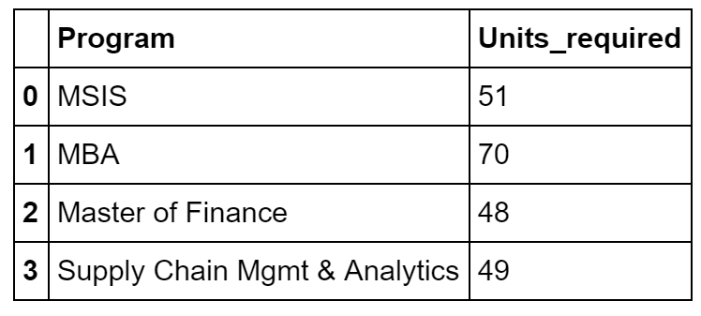
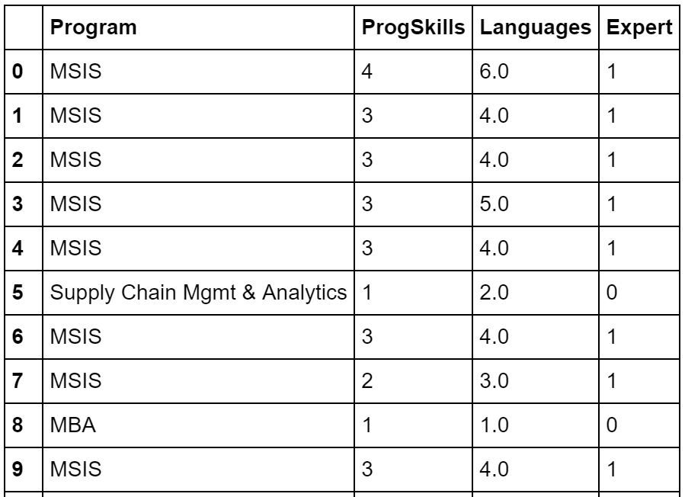
Merge
Goal: retrieve information from a table to another
We want to bring the information on the units required from the table on the right to the table on the left

Slide 4
Today’s data set
cleaned_survey.csv

Slide 5
Merge on columns

Slide 6
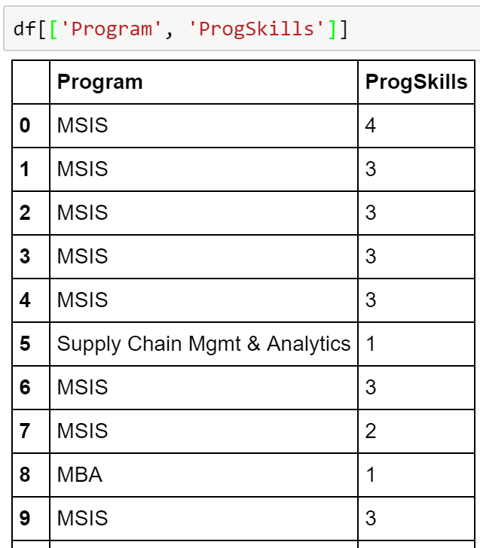
df
One row per student =>

Slide 7
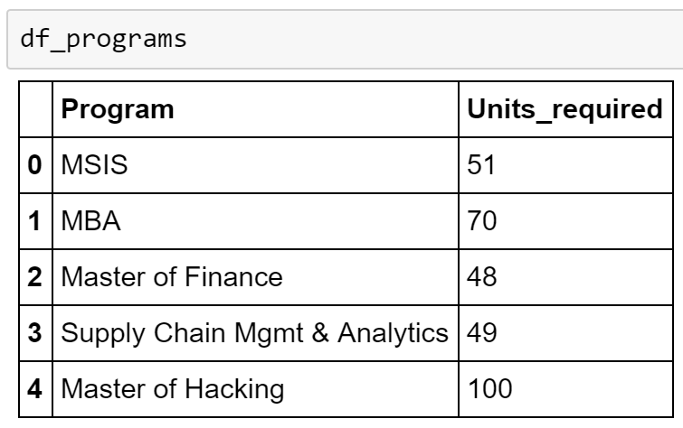
df_programs
One row per Program
A fictitious program

Slide 8
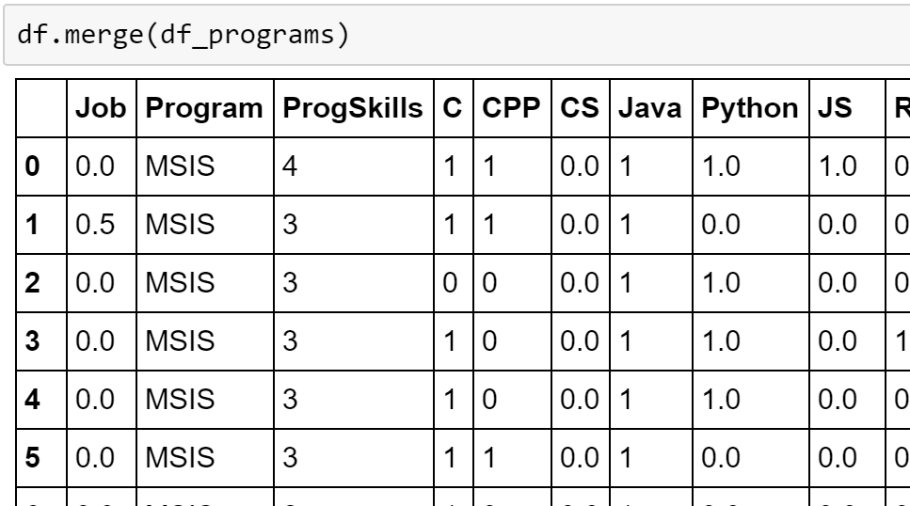
df.merge(other_table)
Performs the merge on the columns with the same name. In this case,
df.Program = df_programs.Program
LEFT TABLE
RIGHT TABLE

Slide 9
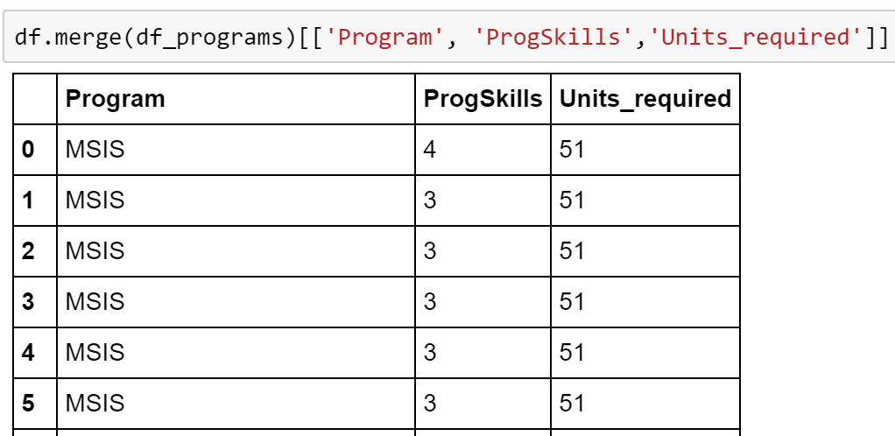
df.merge(other_table)
Let’s show just few columns

Slide 10
df.merge(other_table)
We can specify the keys to merge on for the table on the left (in this case, df) and the table on the right (in this case, df_programs)

Slide 11
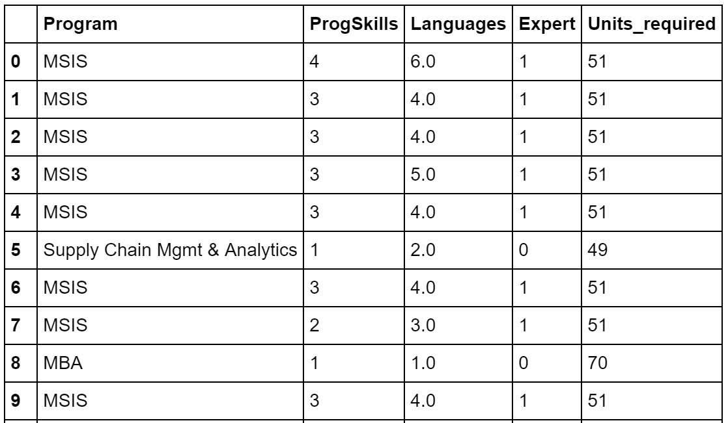
INNER JOIN:
df_programs
df
INNER JOIN:
Only the values in both tables are kept:
“Faculty!” and “Business Man” from df and “Master of Hacking” from df_programs are dropped

Slide 12
LEFT JOIN:
df_programs
df
LEFT JOIN:
All values from the left table are kept:
“Faculty!” and “Business Man” are kept, “Master of Hacking” is not

Slide 13
OUTER JOIN:
df_programs
df
OUTER JOIN:
All values from the both tables are kept:
“Faculty!” and “Business Man” are kept, as well as “Master of Hacking”

Slide 14
Merge on indices

Slide 15
df
One row per student =>

Slide 16
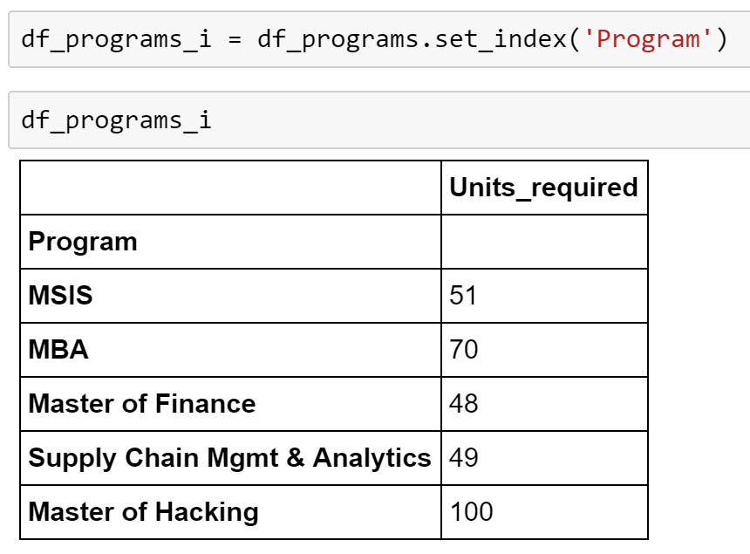
df_programs_i
One row per Program
Program is the index

Slide 17
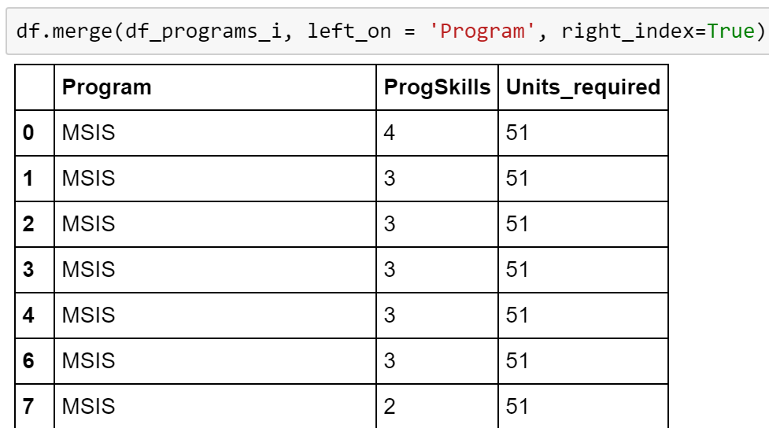
The key to use in the right table is the index

Slide 18
Problems
For each programming skills level, find the average number of units to be completed by students with that programming skill level
For each existing program (i.e., for each Program in df_programs), find the units required to complete it and the number of students belonging to that program that responded to the survey.
For each student in df_students, the number of weekly hours they are working, assuming that:
each required unit of coursework is 0.25 hours a week of work
Job=0 is 0 hours a week of work
Job=0.5 is 20 hours a week of work
Job=1 is 40 hours a week of work

